Slide 1
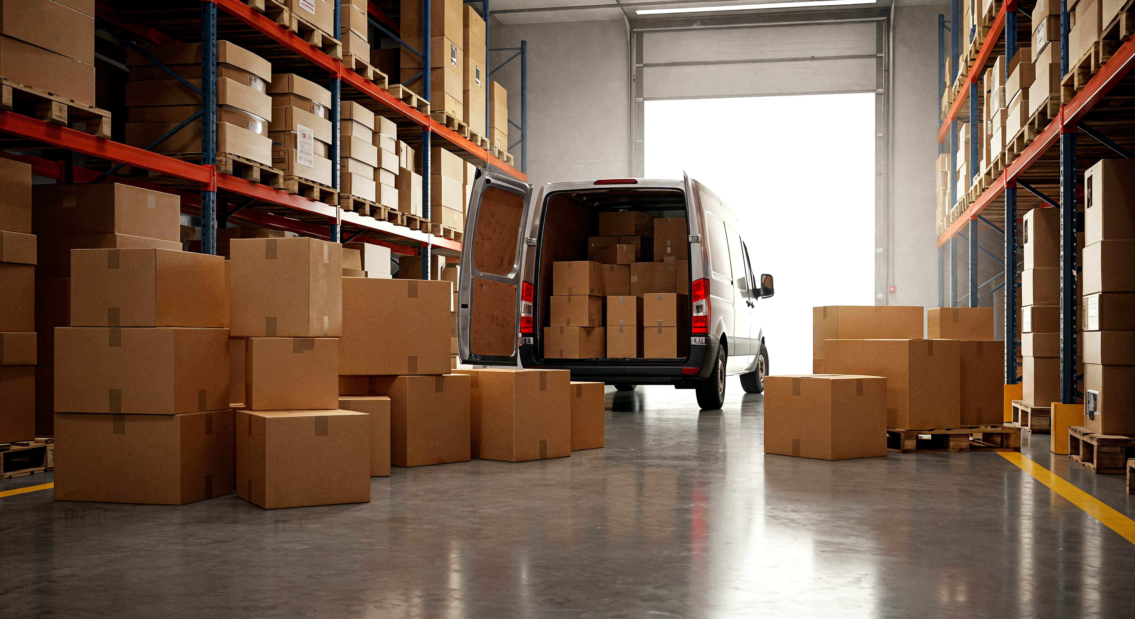
Presentation: Prepared for Three Logistics Michael Kodua Boamah | Data Analyst
July 29, 2025

Slide 2
Business Problems
Business Problems
Possible Effects
Possible Implications
Customer dissatisfaction
Supply chain disruption
Wasted resources
Poor planning decisions
Loss of trust
Reduced repeat business
Revenue loss
Reduce customer retention
Hinders scalability
Higher support costs
Competitive disadvantage
Weak brand reputation
Late deliveries and inefficiencies
Underutilized fleet
Customer complaints about tracking

Slide 3
Analysis and recommendations
Identified patterns in delivery times
and fleet usage
2. Found the root cause of the customer satisfaction scores
3. Recommendations backed by data

Slide 4
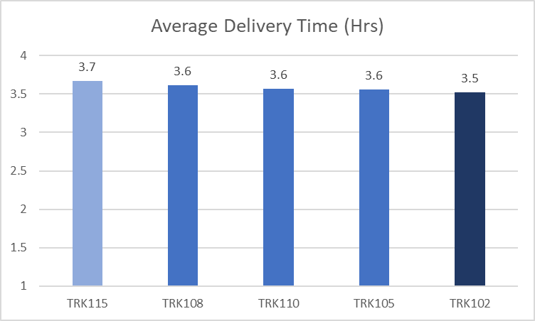
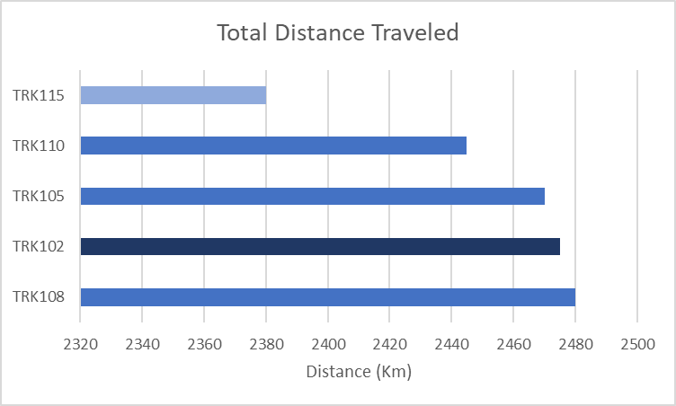
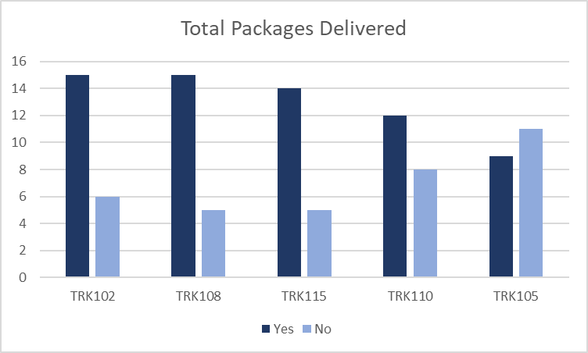
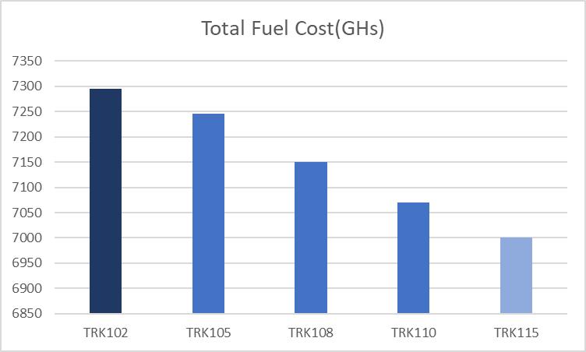
Considerable differences in delivery distances, fuel cost and distance covered by each truck indicating some trucks are underused
TRK108 provides the best performance, and TRK105 provides the worst performance
Recommendation
Integrate Samsara to monitor the distance covered, deliveries completed, delivery time and fuel consumed by each truck. This would be integrated into a live dashboard
Integrate delivery distance, real-time GPS and live map to adapt schedules to enable an efficient planning of trips and respond to possible delays.
Truck TRK108 is suitable for long distance deliveries based on it’s fuel efficiency and overall performance.
Truck Performance Analysis
5
22

Slide 5
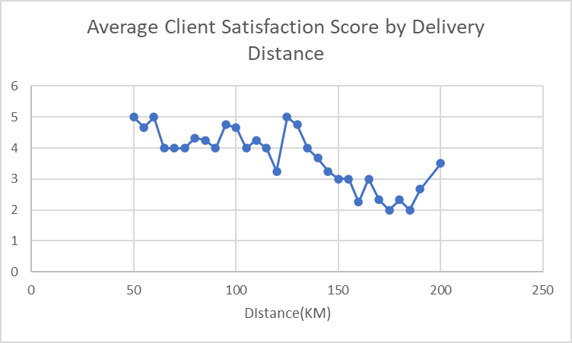
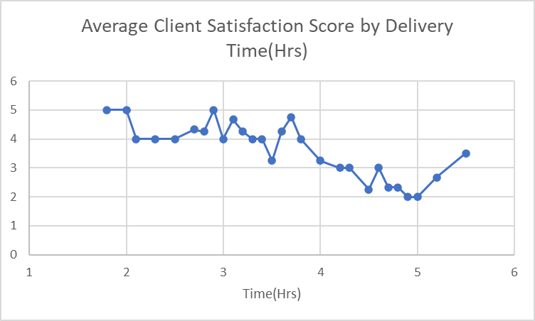
Clients Satisfaction Analysis
Longer delivery distances increased delivery time
Longer delivery times caused negative client reactions, this resulted to a client satisfaction scores of 3 or lower.
Delivery beyond 4.59 hours or 165 kms triggered client reactions leading to client satisfaction scores of 3 or lower.
Clients satisfaction score decreased as delivery time and distance increased
Recommendations
Flag deliveries over 165 km or 4.59 hours ETA for prioritization, enhanced client communication, and distance based loyalty incentives like discounts. This should promote client return and increase client tolerance.
Build a system that integrates OptimoRoute or Routific to improve delivery time prediction accuracy and build client confidence through live tracking access and notifications.
5
22

Slide 6
Summary of recommendations
Recommendation 1
Flag deliveries over 165 km or 4.59 hours ETA for prioritization, enhanced client communication, and distance based loyalty incentives
Recommendation 2
Integrate OptimoRoute or Routific to improve delivery time prediction accuracy to build client confidence through live tracking access, notifications and feedback channels.
Recommendation 3
Establish a tracking system that monitors the distance covered and the number of deliveries completed by each truck
Recommendation 4
Integrate delivery distance, real-time GPS and live map to adapt schedules to enable an efficient planning of trips and respond to possible delays.
Recommendation 5
TRK108 is suitable for long distance deliveries based on it’s fuel efficiency and overall performance.

